Slide 1
Lesson U01.03
Aim: How do we read error message and use them write programs?

Slide 2
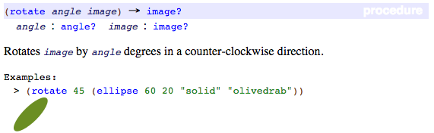
notes 1/4 - Contract Review
This page from the documentation becomes the entry in our contract library below.
Compare them to review how to write a contract.
; rotate: angle image -> image
; consumes a number between 1 and 360 and produces an image rotated counterclockwise

Slide 3
Notebook Check
Notebooks will be checked each week.
Your notebooks will be checked today during your Bug Hunting activity.
Notebook checks are worth 100 participation points

Slide 4
notes 2/4 - Common Errors
Leaving out the beginning left-parenthesis
Leaving out the ending right-parenthesis
Misspelling the operation name
Too few or too many arguments
Putting the operation and arguments in the wrong order
Doing something different from what you meant

Slide 5
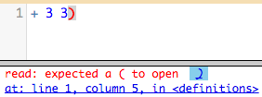
notes 3/4 - Error messages
Rember
error message: information from the computer about errors in code
How does this error message try to help you fix your program?
Write an explanation in your notes

Slide 6
notes 4/4 - more about contracts
what goes into the function is what the function consumes. This is called the domain.
; rotate: angle image -> image
What comes out of the function is what the function produces. This is called the range.

Slide 7
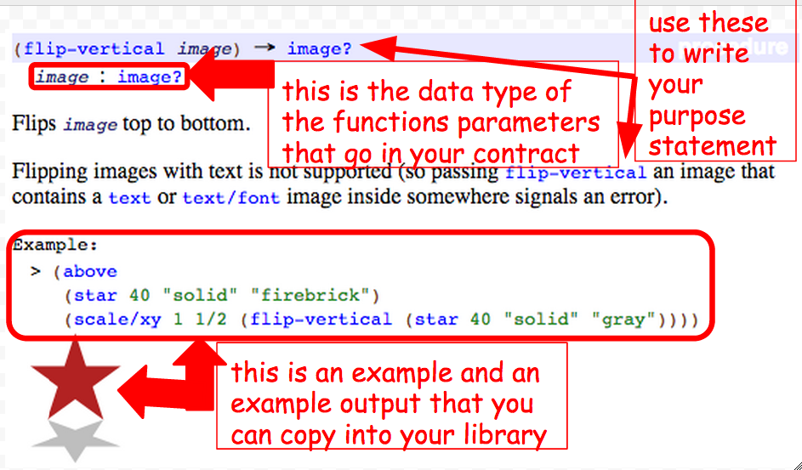
Documentation to Contracts

Slide 8
Angles
Data Types | Functions that produce this data type | Functions that use this data type as arguments
numbers | +, -, /, *, string-length | circle, star, rectangle
strings | string-append | string-length
images | circle, place-image, star | above, below, beside
angles |  | rotate

Slide 9
Announcement
Mid-Unit Formative Assessment
40 points
Monday, 9/22
Scope: All notes from 9/8 - 9/18. Study all notes over the weekend.
Level: Introduced to skill. You should be able to recognize key terms and concepts.

Slide 10
What will be on the assessment?
Draw a circle of evaluation given code
Recognize the rules of brainstorming
Identify common programming errors
Analyze a contract and purpose statement
Recognize all vocabulary words
Write code given a problem statement
Write a function example from a contract

Slide 11
How do we study?
What are the strategies and techniques that we can use to be successful on our first major assessment?

